Slide 1
PROJECT STRONGBOX
Capitalizing on Security, Performance, and Energy Tradeoffs in Full Drive/Disk Encryption Schemes for Fun and Profit
BERNARD DICKENS III HARYADI S. GUNAWI DAVID CASH ARIEL J. FELDMAN HENRY HOFFMANN

Slide 2
STRONGBOX
StrongBox I
We overturn the conventional wisdom regarding FDE: stream ciphers are suitable for FDE!
We develop and implement a secure approach to FDE based on the ChaCha20 stream cipher, F2FS LFS, and RPMB eMMC trusted hardware

Slide 3
STRONGBOX
StrongBox I
We overturn the conventional wisdom regarding FDE: stream ciphers are suitable for FDE!
We develop and implement a secure approach to FDE based on the ChaCha20 stream cipher, F2FS LFS, and RPMB eMMC trusted hardware
StrongBox II
We consider the tradeoff space and motivated use cases formed between ciphers other than just ChaCha20 (e.g. Freestyle, Rabbit, AES-CTR)

Slide 4
STRONGBOX
StrongBox I
We overturn the conventional wisdom regarding FDE: stream ciphers are suitable for FDE!
We develop and implement a secure approach to FDE based on the ChaCha20 stream cipher, F2FS LFS, and RPMB eMMC trusted hardware
StrongBox II
We consider the tradeoff space and motivated use cases formed between ciphers other than just ChaCha20 (e.g. Freestyle, Rabbit, AES-CTR)
StrongBox III
We present a novel theoretical framework for FDE and formally evaluate the security guarantees of our (and other) constructions

Slide 5
STRONGBOX
StrongBox I
We overturn the conventional wisdom regarding FDE: stream ciphers are suitable for FDE!
We develop and implement a secure approach to FDE based on the ChaCha20 stream cipher, F2FS LFS, and RPMB eMMC trusted hardware
StrongBox II
We consider the tradeoff space and motivated use cases formed between ciphers other than just ChaCha20 (e.g. Freestyle, Rabbit, AES-CTR)
StrongBox III
We present a novel theoretical framework for FDE and formally evaluate the security guarantees of our (and other) constructions

Slide 6

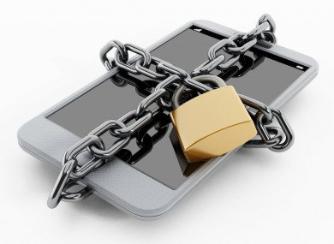

FULL DRIVE (DISK) ENCRYPTION?
STRONGBOX I

Slide 7
FULL DRIVE (DISK) ENCRYPTION?
Industry standard for FDE: AES-XTS
STRONGBOX I

Slide 8
AES BLOCK CIPHER IN XTS MODE
AES is a block cipher
STRONGBOX I

Slide 9

AES BLOCK CIPHER IN XTS MODE
AES is a block cipher
Inspired by traditional spinning disk storage
STRONGBOX I

Slide 10
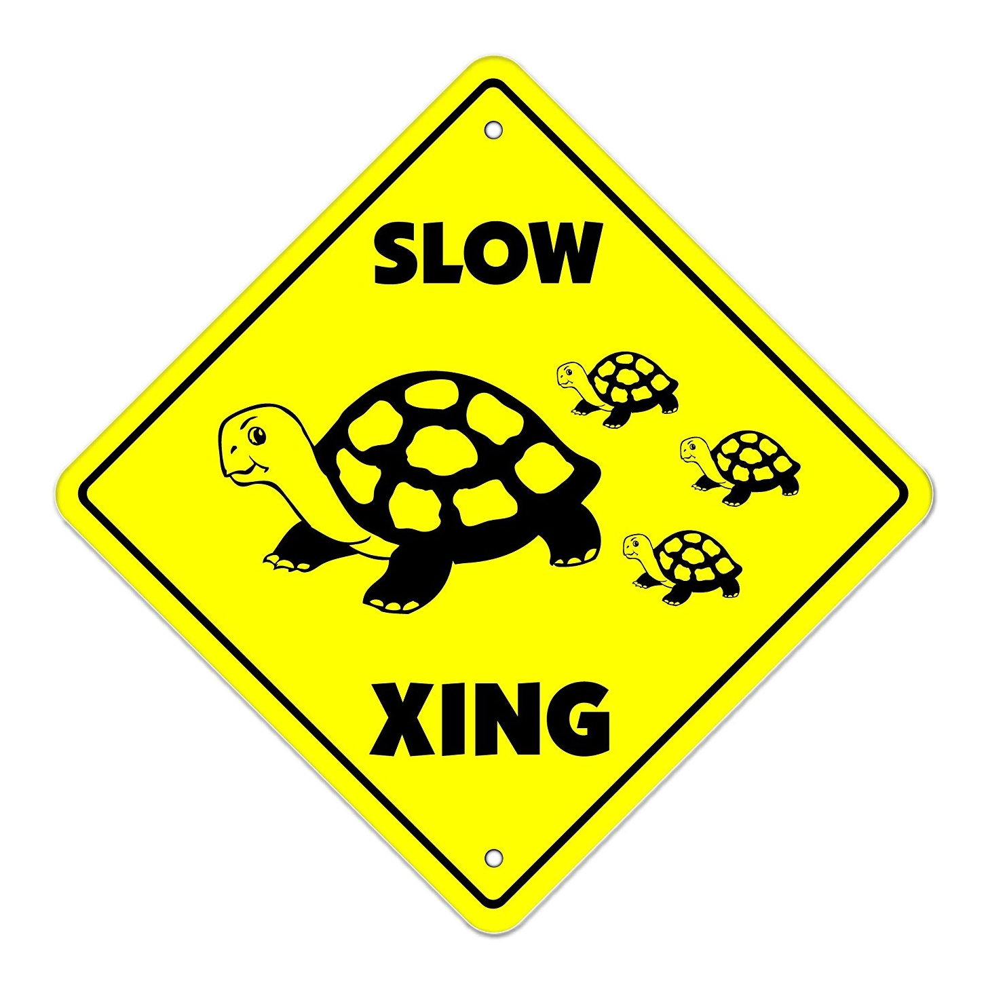
AES BLOCK CIPHER IN XTS MODE
AES is a block cipher
Inspired by traditional spinning disk storage
Problem: AES-XTS is SLOW
DATA
AES-XTS
DATA
DATA
STRONGBOX I

Slide 11
AES BLOCK CIPHER IN XTS MODE
AES is a block cipher
Inspired by traditional spinning disk storage
Problem: AES-XTS is SLOW
Cause: narrow AES “blocks,” wide disk sectors
DISK SECTOR
STRONGBOX I

Slide 12
AES BLOCK CIPHER IN XTS MODE
AES is a block cipher
Inspired by traditional spinning disk storage
Problem: AES-XTS is SLOW
Cause: narrow AES “blocks,” wide disk sectors
DISK SECTOR
STRONGBOX I

Slide 13
AES BLOCK CIPHER IN XTS MODE
AES is a block cipher
Inspired by traditional spinning disk storage
Problem: AES-XTS is SLOW
Cause: narrow AES “blocks,” wide disk sectors
DISK SECTOR
STRONGBOX I

Slide 14
AES BLOCK CIPHER IN XTS MODE
AES is a block cipher
Inspired by traditional spinning disk storage
Problem: AES-XTS is SLOW
Cause: narrow AES “blocks,” wide disk sectors
DISK SECTOR
STRONGBOX I

Slide 15
AES BLOCK CIPHER IN XTS MODE
AES is a block cipher
Inspired by traditional spinning disk storage
Problem: AES-XTS is SLOW
Cause: narrow AES “blocks,” wide disk sectors
DISK SECTOR
STRONGBOX I

Slide 16
AES BLOCK CIPHER IN XTS MODE
AES is a block cipher
Inspired by traditional spinning disk storage
Problem: AES-XTS is SLOW
Cause: narrow AES “blocks,” wide disk sectors
DISK SECTOR
FINALLY DONE!
STRONGBOX I

Slide 17
BLOCKS VERSUS STREAMS
Stream ciphers are also a thing
STRONGBOX I

Slide 18
BLOCKS VERSUS STREAMS
Stream ciphers are also a thing
Data encrypted via XOR as a continuous stream
Your Data:
1
1
1
0
0
1
0
0
⊕
Keystream:
0
1
0
0
1
1
0
1
=
Encrypted:
STRONGBOX I

Slide 19
BLOCKS VERSUS STREAMS
Stream ciphers are also a thing
Data encrypted via XOR as a continuous stream
Stream ciphers are FAST
Cause: XOR (ARX) operation is simple, fast
Your Data:
1
1
1
0
0
1
0
0
⊕
Keystream:
0
1
0
0
1
1
0
1
=
Encrypted:
STRONGBOX I

Slide 20
NOT THE ONLY CIPHER IN TOWN
There are many stream ciphers with various characteristics
STRONGBOX I

Slide 21
NOT THE ONLY CIPHER IN TOWN
There are many stream ciphers with various characteristics
High throughput ciphers
Sosemanuk and Rabbit
STRONGBOX I

Slide 22
NOT THE ONLY CIPHER IN TOWN
There are many stream ciphers with various characteristics
High throughput ciphers
Sosemanuk and Rabbit
Software/energy efficient ciphers
ChaCha and Salsa
STRONGBOX I

Slide 23
NOT THE ONLY CIPHER IN TOWN
There are many stream ciphers with various characteristics
High throughput ciphers
Sosemanuk and Rabbit
Software/energy efficient ciphers
ChaCha and Salsa
Tweakable overwrite-resistant ciphers
Freestyle
STRONGBOX I

Slide 24
NOT THE ONLY CIPHER IN TOWN
There are many stream ciphers with various characteristics
High throughput ciphers
Sosemanuk and Rabbit
Software/energy efficient ciphers
ChaCha and Salsa
Tweakable overwrite-resistant ciphers
Freestyle
Hardware-accelerated and other interesting ciphers
Reduced-round ChaCha (e.g. ARM Neon impl)
CTR mode block ciphers (e.g. AES-CTR)
STRONGBOX I

Slide 25

Switch Ciphers, Problem Solved?
STRONGBOX I

Slide 26
Big Problems with Stream Ciphers
There are two big problems with using stream ciphers for FDE:
STRONGBOX I

Slide 27
Big Problems with Stream Ciphers
There are two big problems with using stream ciphers for FDE:
Data confidentiality can be trivially violated with overwrites
STRONGBOX I

Slide 28
Big Problems with Stream Ciphers
There are two big problems with using stream ciphers for FDE:
Data confidentiality can be trivially violated with overwrites
Rolling back the system to a previously valid state also leads to confidentiality violations
STRONGBOX I

Slide 29
Overwrites Are a Big Deal
Why are overwrites such a problem?
Overwrites violate confidentiality
Rollbacks lead to overwrites

Slide 30


Overwrites Are a Big Deal
Why are overwrites such a problem?
Your Data:
Keystream:
Overwrites violate confidentiality
Rollbacks lead to overwrites

Slide 31


Overwrites Are a Big Deal
Why are overwrites such a problem?
Your Data:
⊕ =>
Keystream:
Encrypted
Overwrites violate confidentiality
Rollbacks lead to overwrites

Slide 32

Overwrites Are a Big Deal
Why are overwrites such a problem?
Your Data:
(the same)
Keystream:
Overwrites violate confidentiality
Rollbacks lead to overwrites

Slide 33


Overwrites Are a Big Deal
Why are overwrites such a problem?
Your Data:
⊕ =>
(the same)
Encrypted?
Keystream:
Overwrites violate confidentiality
Rollbacks lead to overwrites

Slide 34
Overwrites Are a Big Deal
Why are overwrites such a problem?
Original Write:
d’ ⊕ pad = c’
(i.e. same keystream)
Overwrite:
Overwrites violate confidentiality
Rollbacks lead to overwrites

Slide 35


Overwrites Are a Big Deal
Why are overwrites such a problem?
Original Write:
d’ ⊕ pad = c’
⊕ =>
(i.e. same keystream)
ENCRYPTION BROKEN!
Overwrite:
Overwrites violate confidentiality
Rollbacks lead to overwrites

Slide 36
Overwrites Are a Big Deal
Why are overwrites such a problem?
The solution: “rekey” the keystream on every overwrite
Overwrites violate confidentiality
Rollbacks lead to overwrites

Slide 37
Overwrites Are a Big Deal
Why are overwrites such a problem?
The solution: “rekey” the keystream on every overwrite
Another problem: rekeying is expensive!
Overwrites violate confidentiality
Rollbacks lead to overwrites

Slide 38
Overwrites Are a Big Deal
Why are overwrites such a problem?
The solution: “rekey” the keystream on every overwrite
Another problem: rekeying is expensive!
Out of ~17,000 write ops, EXT4 makes ~10,000 overwrites
10,000 x expensive operation = performance degradation
This expense negates perf benefit of the stream cipher
Overwrites violate confidentiality
Rollbacks lead to overwrites

Slide 39

ROLLBACKs Are Compromising
Rollbacks are even worse!
Overwrites violate confidentiality
Rollbacks lead to overwrites

Slide 40
ROLLBACKs Are Compromising
Rollbacks are even worse!
Take a snapshot of the system at valid state
Overwrites violate confidentiality
Rollbacks lead to overwrites

Slide 41
ROLLBACKs Are Compromising
Rollbacks are even worse!
Take a snapshot of the system at valid state
Rollback the system to a previous valid state
Overwrites violate confidentiality
Rollbacks lead to overwrites

Slide 42
ROLLBACKs Are Compromising
Rollbacks are even worse!
Take a snapshot of the system at valid state
Rollback the system to a previous valid state
Allow writes as normal
Overwrites violate confidentiality
Rollbacks lead to overwrites

Slide 43
ROLLBACKs Are Compromising
Rollbacks are even worse!
Take a snapshot of the system at valid state
Rollback the system to a previous valid state
Allow writes as normal
Contrast (XOR) encrypted snapshot with current “encrypted” state
SAME AS AN OVERWRITE!
Overwrites violate confidentiality
Rollbacks lead to overwrites

Slide 44

No!
You can only use
a block cipher for
Full Drive
Encryption!

Slide 45
The Old Assumption
Stream ciphers are faster…
… but the overhead of dealing with overwrites and rollbacks negates any potential perf benefit
Hence, AES-XTS is the industry standard
STRONGBOX I

Slide 46
the Old Assumption: Invalidated
Key insight: two technology trends invalidate old assumption
STRONGBOX I

Slide 47
the Old Assumption: Invalidated
Key insight: two technology trends invalidate old assumption
Non-volatile flash memory as secondary storage
Governed by Flash Translation Layer (FTL)
FTL tends to avoid overwriting same cells (wear-leveling)
STRONGBOX I

Slide 48
the Old Assumption: Invalidated
Key insight: two technology trends invalidate old assumption
Non-volatile flash memory as secondary storage
Governed by Flash Translation Layer (FTL)
FTL tends to avoid overwriting same cells (wear-leveling)
Proliferation of secure hardware
TPM/TEE implemented by nearly all computer and mobile device manufacturers
Secure hardware allows us to actively version system state and detect rollbacks
STRONGBOX I

Slide 49
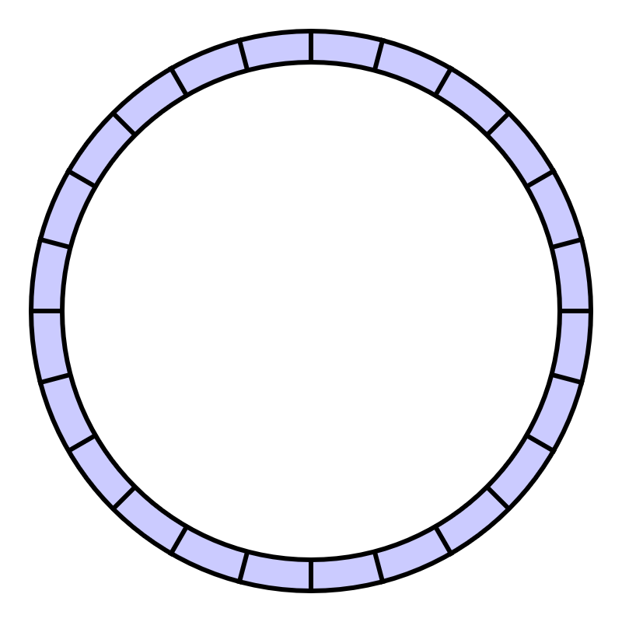
FTL <=> LFS
FTL operates like a Log-structured File System (LFS)
FTL = LFS = append-only writes
(naturally avoids overwrites)
STRONGBOX I

Slide 50
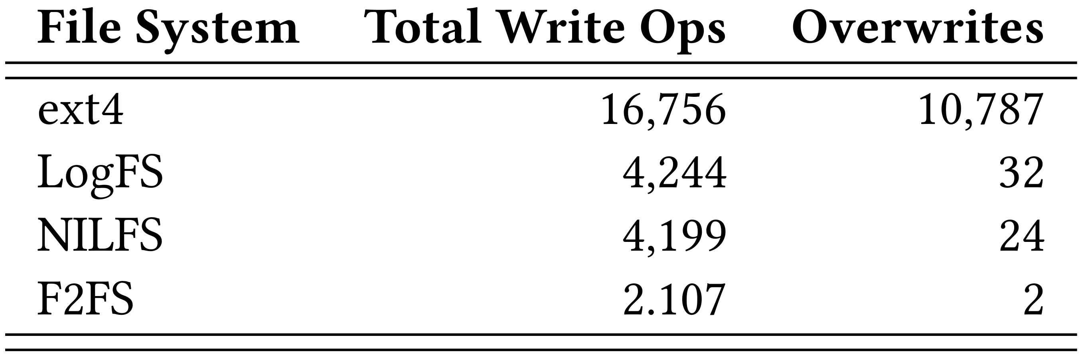
LFS Makes Few Overwrites
STRONGBOX I

Slide 51

Actively Versioning System State
TPM/TEE allows us to actively version system state
STRONGBOX I

Slide 52
Actively Versioning System State
TPM/TEE allows us to actively version system state
Accomplished with fast secure monotonic counters
STRONGBOX I

Slide 53
Actively Versioning System State
TPM/TEE allows us to actively version system state
Accomplished with fast secure monotonic counters
These hardware counters cannot be rolled back!
STRONGBOX I

Slide 54

The Grand Solution
Leveraging the trends, we proposed StrongBox
A drop-in replacement for AES-backed FDE providers such as dm-crypt
Uses a stream cipher instead of the AES-XTS block cipher
Uses an LFS to avoid overwrites and rekeying penalties
Uses secure monotonic counters to prevent rollbacks
STRONGBOX I

Slide 55
Threat Model
Confidentiality
dm-crypt (AES-XTS): AES block cipher
StrongBox: ChaCha20 stream cipher
STRONGBOX I

Slide 56
Threat Model
Confidentiality
dm-crypt (AES-XTS): AES block cipher
StrongBox: ChaCha20 stream cipher
Overwrites (many-time pad)
dm-crypt (AES-XTS): N/A
StrongBox: append-only write property of FTL/LFS
STRONGBOX I

Slide 57
Threat Model (continued)
Rollbacks
dm-crypt (AES-XTS): N/A
StrongBox: secure monotonic counters
STRONGBOX I

Slide 58
Threat Model (continued)
Rollbacks
dm-crypt (AES-XTS): N/A
StrongBox: secure monotonic counters
Integrity
dm-crypt (AES-XTS): hopefully the user is paying attention
StrongBox: hashing scheme to tie system state to counter
STRONGBOX I

Slide 59
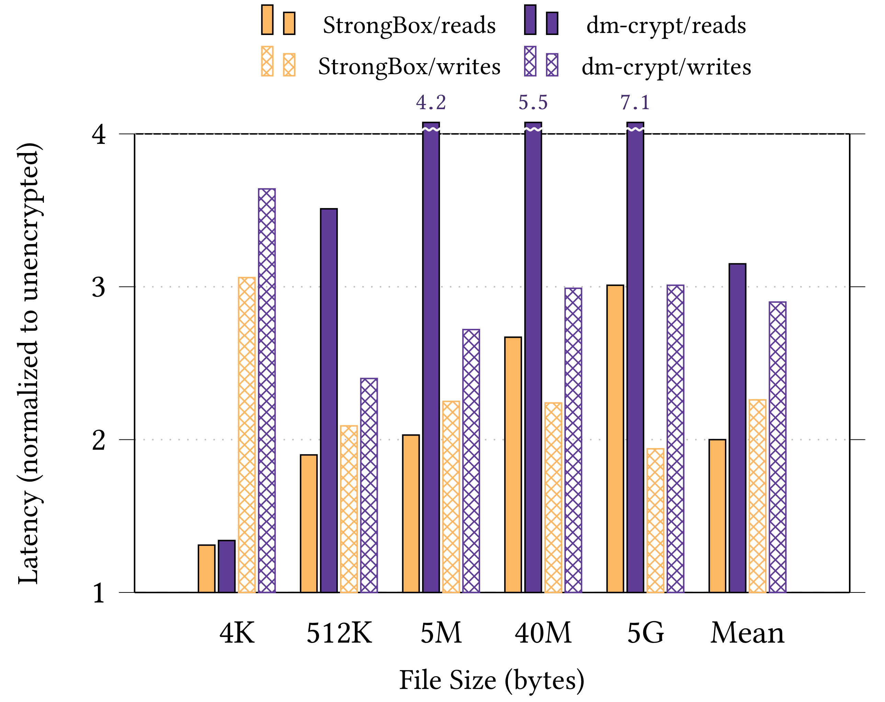
Performance Win
By harmonic mean:
1.7x faster reads
1.3x faster writes
Experimental setup:
Odroid XU3 ARM big.LITTLE system
eMMC 5.0HS400 backing store
STRONGBOX I

Slide 60
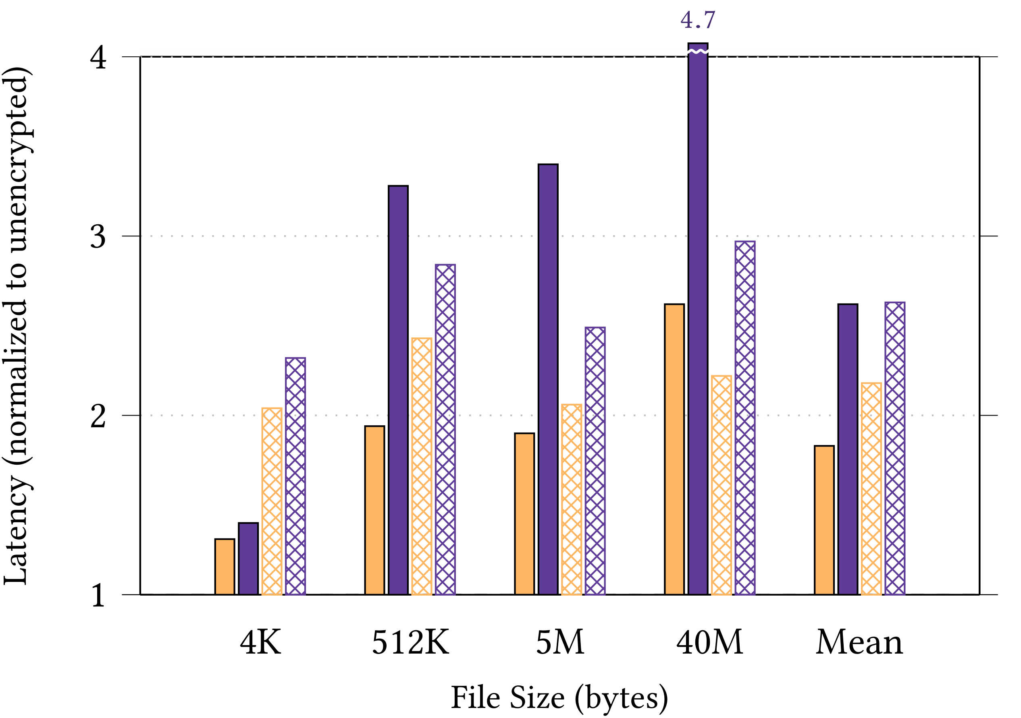
Performance Win (Random IO)
By harmonic mean:
1.7x faster reads
1.3x faster writes
Experimental setup:
Odroid XU3 ARM big.LITTLE system
eMMC 5.0HS400 backing store
STRONGBOX I

Slide 61
Hardware Accelerated AES?
What about hardware support for AES (i.e. AES-NI?)
STRONGBOX I

Slide 62
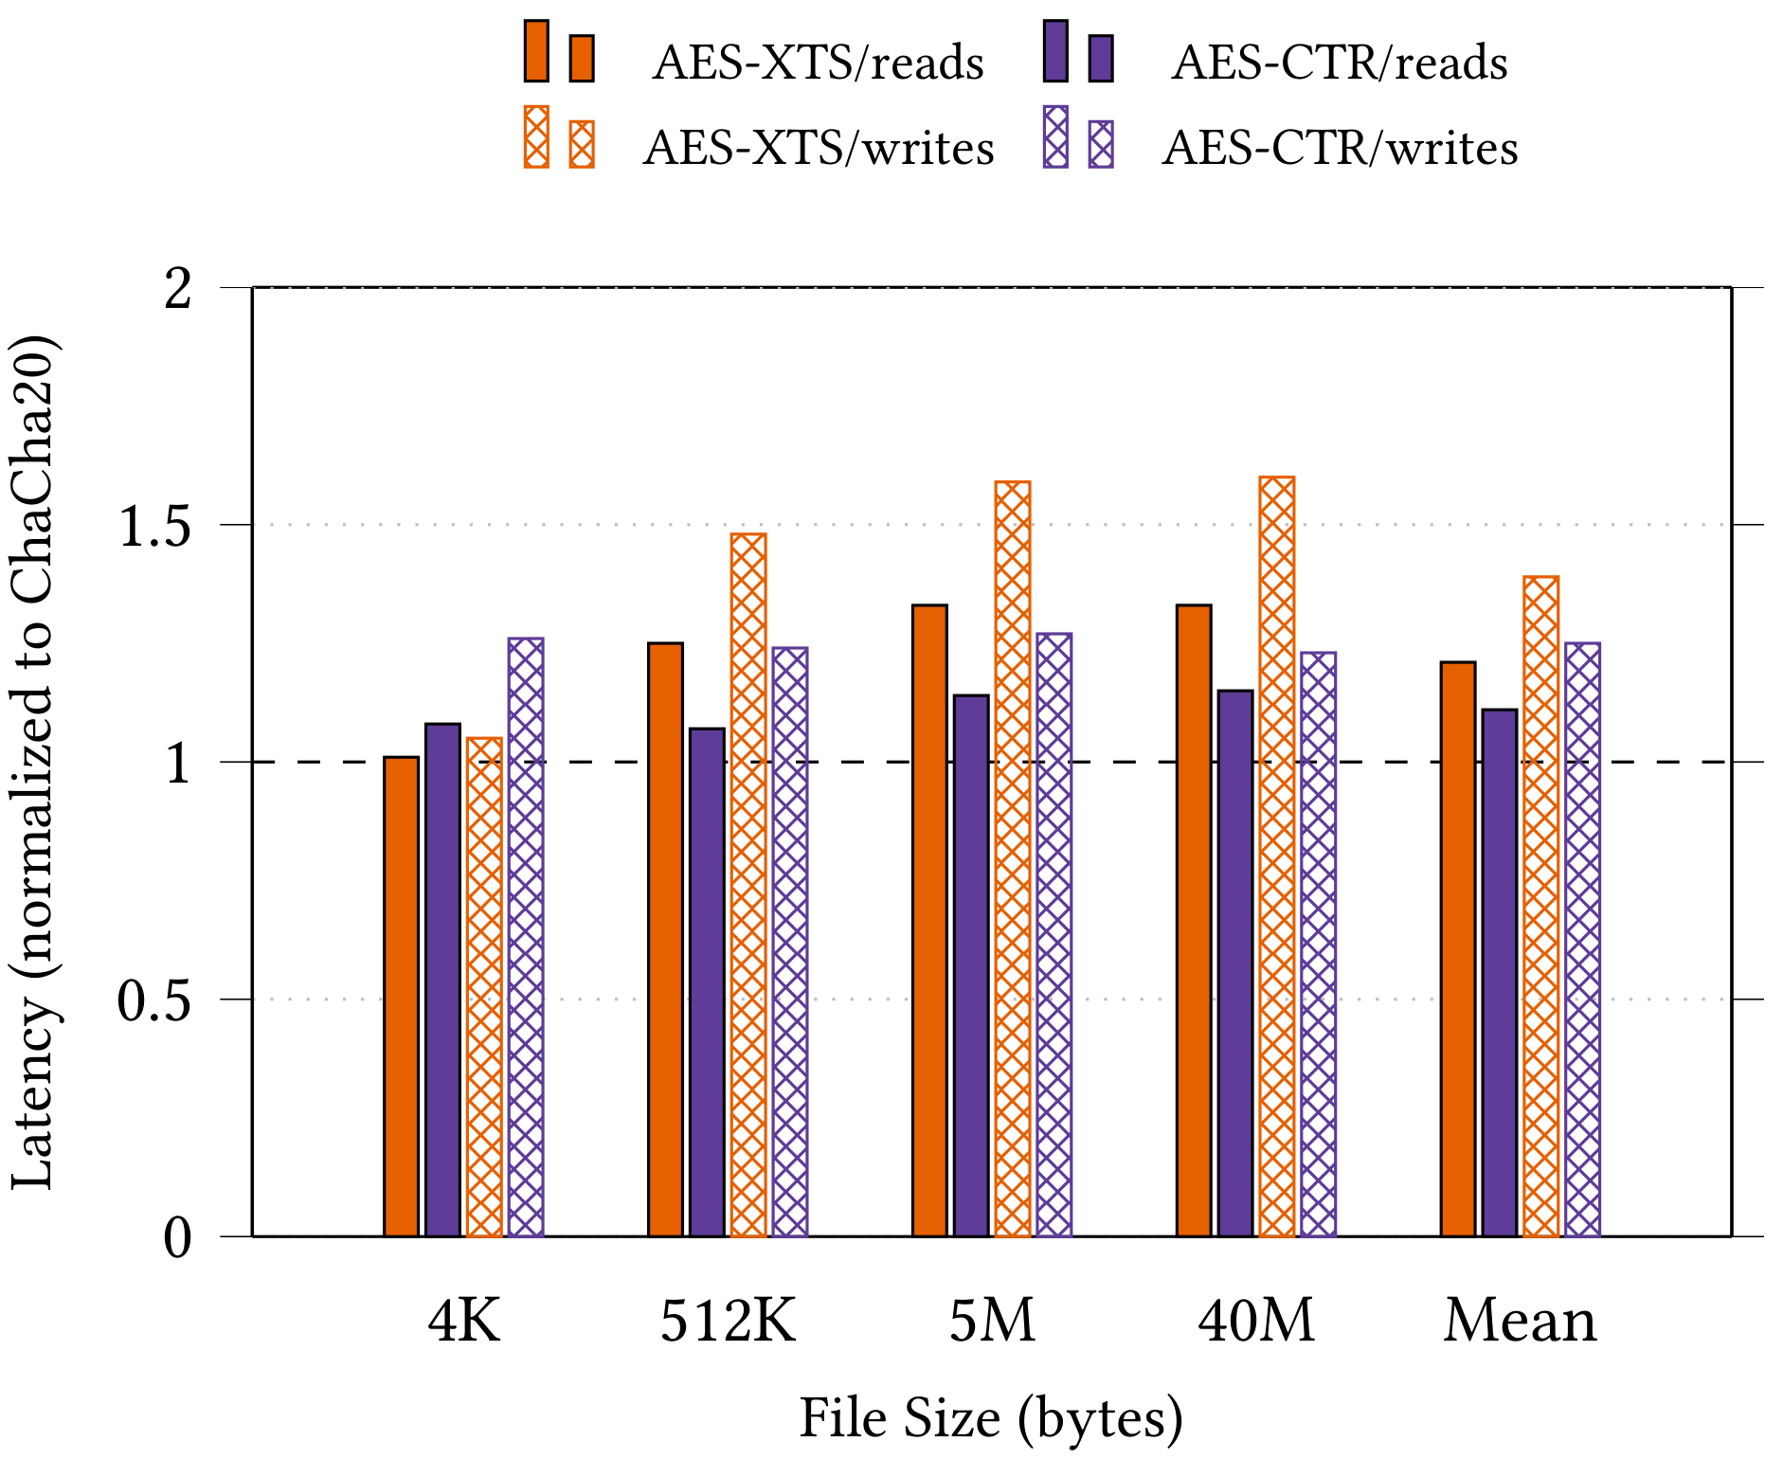
AES Block Cipher In CTR Mode
STRONGBOX I

Slide 63
other stream ciphers?
What can we gain with ciphers other than ChaCha20?

Slide 64
STRONGBOX
StrongBox I
We update the conventional wisdom regarding FDE: stream ciphers are suitable for FDE!
We develop and implement a secure approach to FDE based on the ChaCha20 stream cipher, F2FS LFS, and RPMB eMMC trusted hardware
StrongBox II
We consider the tradeoff space and motivated use cases formed between ciphers other than just ChaCha20 (e.g. Freestyle, Rabbit, AES-CTR)
StrongBox III
We present a novel theoretical framework for FDE and formally evaluate the security guarantees of our (and other) constructions

Slide 65


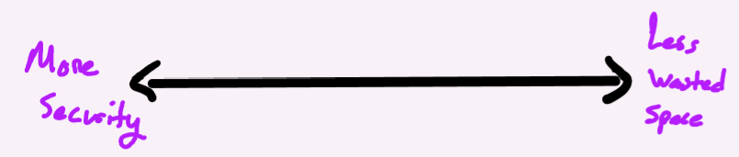
BEYOND CHACHA20
Different ciphers behave differently under StrongBox
Various security guarantees offered
Various performance and power profiles for a given workload
Various storage requirements per block beyond StrongBox metadata storage
STRONGBOX II

Slide 66
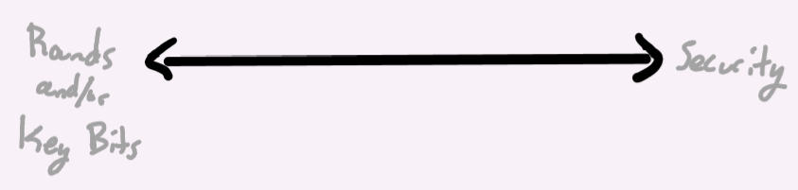
BEYOND CHACHA20
Different ciphers behave differently under StrongBox
Various security guarantees offered
Various performance and power profiles for a given workload
Various storage requirements per block beyond StrongBox metadata storage
Some cipher parameters can be explicitly tuned
e.g. rounds, algorithmic complexity, initialization steps
STRONGBOX II

Slide 67

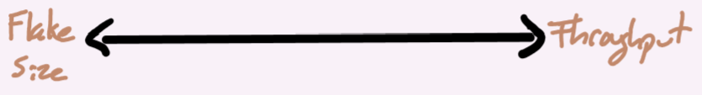
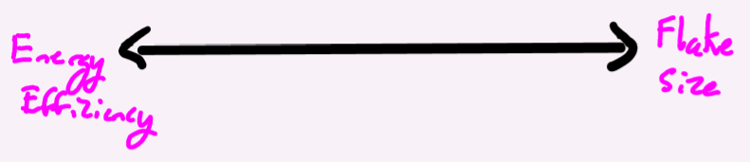
BEYOND CHACHA20
Different ciphers behave differently under StrongBox
Various security guarantees offered
Various performance and power profiles for a given workload
Various storage requirements per block beyond StrongBox metadata storage
Some cipher parameters can be explicitly tuned
e.g. rounds, algorithmic complexity, initialization steps
StrongBox itself has tunable parameters (e.g. flake size)
STRONGBOX II

Slide 68

BEYOND CHACHA20
Different ciphers behave differently under StrongBox
Various security guarantees offered
Various performance and power profiles for a given workload
Various storage requirements per block beyond StrongBox metadata storage
Some cipher parameters can be explicitly tuned
e.g. rounds, algorithmic complexity, initialization steps
StrongBox itself has tunable parameters (e.g. flake size)
Other choices
STRONGBOX II

Slide 69
BEYOND CHACHA20
Different ciphers behave differently under StrongBox
Various security guarantees offered
Various performance and power profiles for a given workload
Various storage requirements per block beyond StrongBox metadata storage
Some cipher parameters can be explicitly tuned
e.g. rounds, algorithmic complexity, initialization steps
StrongBox itself has tunable parameters (e.g. flake size)
Other choices
Can we leverage this diversity to our benefit? Yes!
STRONGBOX II

Slide 70
Motivating Cipher Switching
Dynamically navigating tradeoffs for profit is well-studied
Minimizing energy profiles (POET, CoPPer; Imes et al)
Approximation, self-aware systems (a lot; Hoffmann)
Learned models + control theory (CALOREE; Mishra et al)
Complex config optimization (SmartConf; Wang et al)
STRONGBOX II

Slide 71
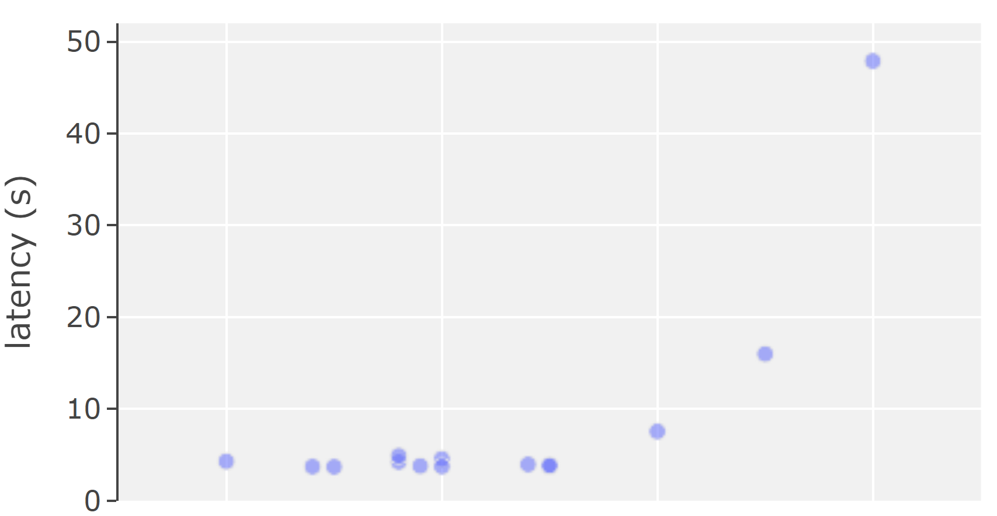
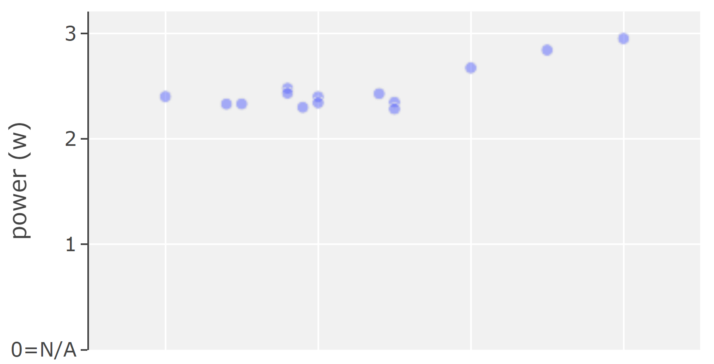
Motivating Cipher Switching (cont.)
Dynamically navigating tradeoffs for profit is well-studied
Comparing ciphers, we observe non-linear relationships between tradeoff dimensions
Tradeoff spaces are here! Need a “knob” to navigate them
Two examples: security vs latency, power; observed pareto curves for 19 ciphers in various configurations (under StrongBox)
STRONGBOX II

Slide 72
“Quantifying” Security
Ideal: cipher rank distributed evenly along a continuous “security gradient”
Allows us to communicate desired security to the system easily
STRONGBOX II

Slide 73
“Quantifying” Security
Ideal: cipher rank distributed evenly along a continuous “security gradient”
Allows us to communicate desired security to the system easily
Reality: ciphers ranked non-uniformly and discretely along “security” axis based on several features
STRONGBOX II

Slide 74
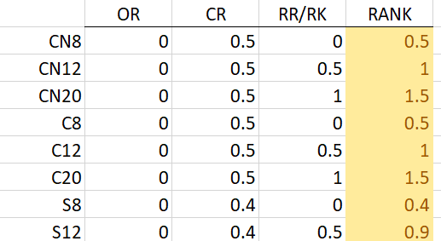
“Quantifying” Security
Ideal: cipher rank distributed evenly along a continuous “security gradient”
Allows us to communicate desired security to the system easily
Reality: ciphers ranked non-uniformly and discretely along “security” axis based on several features
Quantifying features
Output randomization (OR)
Resistance to cryptanalysis (CR)
Relative round/relative key length (RR/RK)
STRONGBOX II

Slide 75
Characterizing Ciphers
Security (quantified)
Our primary knob!
STRONGBOX II

Slide 76
Characterizing Ciphers
Security (quantified)
Our primary knob!
Energy use
Strictly linear? Software vs hardware impl tradeoffs?
STRONGBOX II

Slide 77
Characterizing Ciphers
Security (quantified)
Our primary knob!
Energy use
Strictly linear? Software vs hardware impl tradeoffs?
Performance
Read and write throughput under various StrongBox configurations for sequential and random workloads of varying sizes
STRONGBOX II

Slide 78
Characterizing Ciphers
Security (quantified)
Our primary knob!
Energy use
Strictly linear? Software vs hardware impl tradeoffs?
Performance
Read and write throughput under various StrongBox configurations for sequential and random workloads of varying sizes
Area (i.e. storage requirements)
Some ciphers expand the ciphertext or otherwise require extra data to be stored
STRONGBOX II

Slide 79
Switch Strategies
How can StrongBox effectively switch between and utilize different ciphers on the same system?
STRONGBOX II

Slide 80
Switch Strategies
How can StrongBox effectively switch between and utilize different ciphers on the same system?
Answer: cipher switching strategies
STRONGBOX II

Slide 81
Switch Strategies
How can StrongBox effectively switch between and utilize different ciphers on the same system?
Answer: cipher switching strategies
Immediate (slowest total throughput)
STRONGBOX II

Slide 82
Switch Strategies
How can StrongBox effectively switch between and utilize different ciphers on the same system?
Answer: cipher switching strategies
Immediate (slowest total throughput)
Forward Immediate (best for random IO)
STRONGBOX II

Slide 83
Switch Strategies
How can StrongBox effectively switch between and utilize different ciphers on the same system?
Answer: cipher switching strategies
Immediate (slowest total throughput)
Forward Immediate (best for random IO)
Aggressive Immediate (sequential IO friendly)
STRONGBOX II

Slide 84
Switch Strategies
How can StrongBox effectively switch between and utilize different ciphers on the same system?
Answer: cipher switching strategies
Immediate (slowest total throughput)
Forward Immediate (best for random IO)
Aggressive Immediate (sequential IO friendly)
Opportunistic Immediate (reduces to forward-immediate)
STRONGBOX II

Slide 85
Switch Strategies
How can StrongBox effectively switch between and utilize different ciphers on the same system?
Answer: cipher switching strategies
Immediate (slowest total throughput)
Forward Immediate (best for random IO)
Aggressive Immediate (sequential IO friendly)
Opportunistic Immediate (reduces to forward-immediate)
Pre-crypt (fastest reads by far, slowest writes)
STRONGBOX II

Slide 86
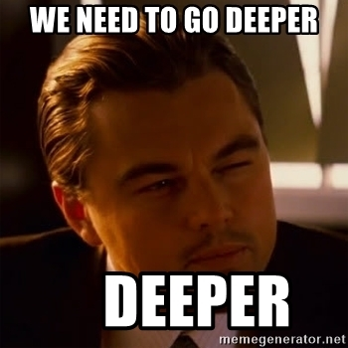
Switch Strategies
How can StrongBox effectively switch between and utilize different ciphers on the same system?
Answer: cipher switching strategies
Immediate (slowest total throughput)
Forward Immediate (best for random IO)
Aggressive Immediate (sequential IO friendly)
Opportunistic Immediate (reduces to forward-immediate)
Pre-crypt (fastest reads by far, slowest writes)
Implying there are higher level (offline) performance/energy tradeoffs between different cipher switching strategies

Slide 87
Strongbox II: GOALS
Select interesting ciphers
Quantify security, other “knobs”
Determine characteristics of ciphers
Implement cipher switching/strategies
Explore contours of tradeoff space(s) of competing concerns
Measure impact of Freestyle’s extra storage requirements
Experiment with so-called “pre-crypt” switching strategy
Model/implement dynamic switching use case scenarios
Use switching strategies to navigate the space for fun and profit
Explicitly state threat models for use cases
STRONGBOX II

Slide 88
Strongbox II: Progress
Select interesting ciphers
Quantify security, other “knobs”
Determine characteristics of ciphers
Implement cipher switching/strategies
Explore contours of tradeoff space(s) of competing concerns
Measure impact of Freestyle’s extra storage requirements
Experiment with so-called “pre-crypt” switching strategy
Model/implement dynamic switching use case scenarios
Use switching strategies to navigate the space for fun and profit
Explicitly state threat models for use cases
STRONGBOX II

Slide 89
STRONGBOX
StrongBox I
We update the conventional wisdom regarding FDE: stream ciphers are suitable for FDE!
We develop and implement a secure approach to FDE based on the ChaCha20 stream cipher, F2FS LFS, and RPMB eMMC trusted hardware
StrongBox II
We consider the tradeoff space and motivated use cases formed between ciphers other than just ChaCha20 (e.g. Freestyle, Rabbit, AES-CTR)
StrongBox III
We present a novel theoretical framework for FDE and formally evaluate the security guarantees of our (and other) constructions

Slide 90
New Security Notions for FDE?
Prior generalized FDE security notions assume deterministic output due to sector number, PBA, etc
This is not valid for ciphers under StrongBox
XOR FDE with stream ciphers/CTR mode are considered trivially vulnerable to known-plaintext attacks
StrongBox avoids this by avoiding overwrites entirely
Indistinguishable under chosen-ciphertext attack?
STRONGBOX III

Slide 91
New Security Notions for FDE?
Prior generalized FDE security notions assume deterministic output due to sector number, PBA, etc
This is not valid for ciphers under StrongBox
XOR FDE with stream ciphers/CTR mode are considered trivially vulnerable to known-plaintext attacks
StrongBox avoids this by avoiding overwrites entirely
Indistinguishable under chosen-ciphertext attack?
We want: well-defined worthy cryptographic goals for StrongBox
STRONGBOX III

Slide 92
Strongbox III: GOALS
Define a new set of formal FDE security notions
STRONGBOX III

Slide 93
Strongbox III: GOALS
Define a new set of formal FDE security notions
Use these notions to construct a theoretical framework to evaluate StrongBox FDE (subject to practical constraints)
E.g. we argue StrongBox with a stream cipher achieves IND-CPA FDE despite traditional wisdom
STRONGBOX III

Slide 94
Strongbox III: GOALS
Define a new set of formal FDE security notions
Use these notions to construct a theoretical framework to evaluate StrongBox FDE (subject to practical constraints)
E.g. we argue StrongBox with a stream cipher achieves IND-CPA FDE despite traditional wisdom
Refine security notions, models; evaluate other relevant constructions versus StrongBox using our framework
STRONGBOX III

Slide 95
Strongbox III: GOALS
Define a new set of formal FDE security notions
Use these notions to construct a theoretical framework to evaluate StrongBox FDE (subject to practical constraints)
E.g. we argue StrongBox with a stream cipher achieves IND-CPA FDE despite traditional wisdom
Refine security notions, models; evaluate other relevant constructions versus StrongBox using our framework
Revisit AES-XTS formal security guarantees versus StrongBox with any valid cipher
STRONGBOX III

Slide 96


INITIAL EXPERIMENTS
IMPLEMENTATION
Literature review and data gathering
6000+ LoC solution and experimental setup
SB I
✔
✔
✔
✔
THREAT MODELING
FOUNDATIONAL PAPER
SB II
Address threats to stream cipher based FDE
ASPLOS 2018
USE CASE STUDIES
PARETO CURVES
Study key tradeoff use cases
Characterize tradeoff space
4/2019
NOW
✔
✔
SB III
CIPHER SWITCHING
CIPHER ABSTRACTION
Implement and experiment with switch strategies
Rebuild StrongBox for multiple ciphers
INITIAL RESEARCH
MODEL EVALUATION
Literature review and organization
Assess and refine security models
5/2019
6/2019
8/2019
12/2019
!
FORMALIZATION
CRYPTANALYSIS
Constructing a useful theoretical framework
StrongBox compared to other constructions

Slide 97
PROJECT STRONGBOX
Questions?
BERNARD DICKENS III HARYADI S. GUNAWI DAVID CASH ARIEL J. FELDMAN HENRY HOFFMANN

